Slide 1
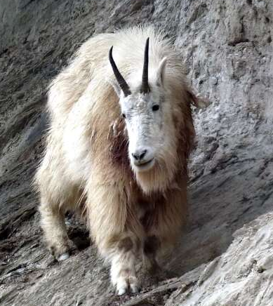
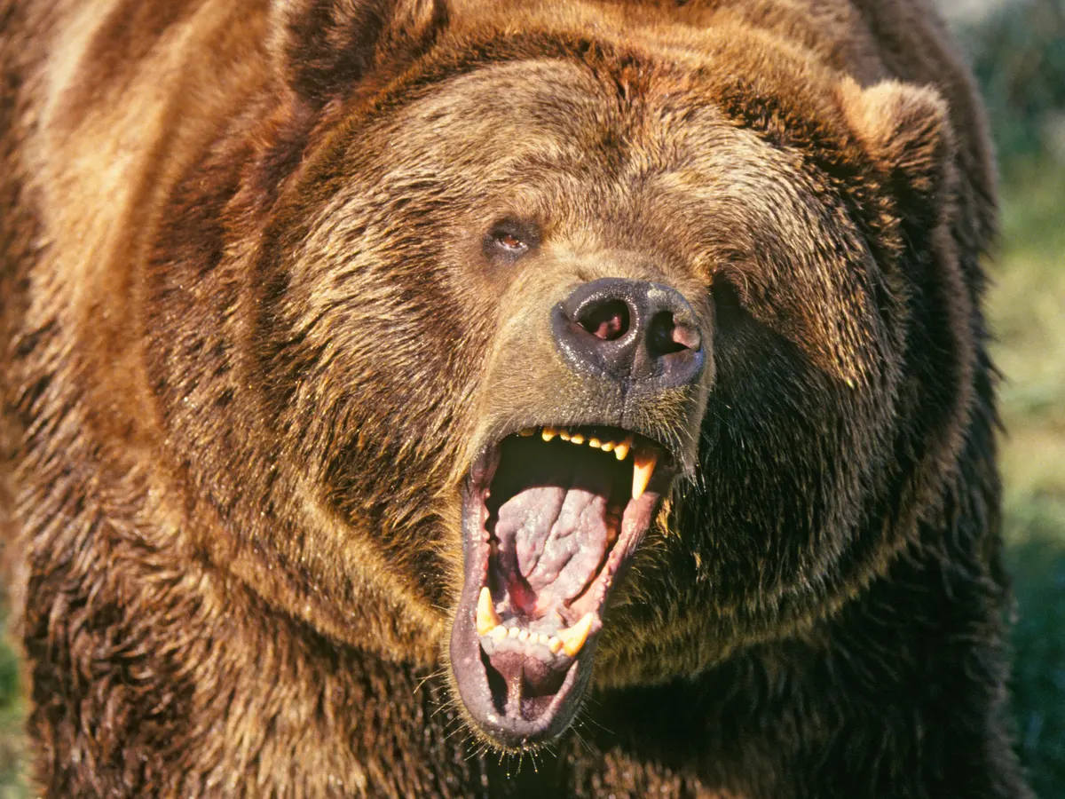
Goat vs Bear

Slide 2
Who would win? Why?

Slide 3
How might a goat beat a bear?

Slide 4
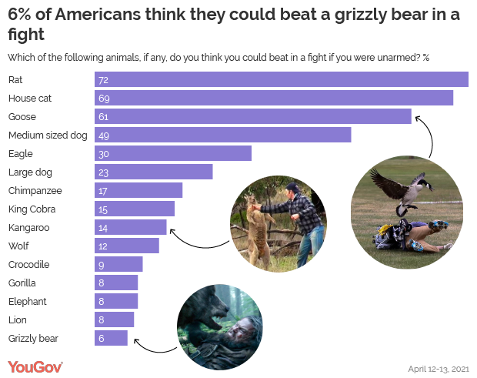

Slide 5
Which animal could you beat in a fight?
How would you do it?

